Slide 1
Introduction to Computational Thermodynamics
Section 3.1
Pressure and Volume Solvers

Slide 2
Introduction
Part 1 showed some fundamentals. Primarily, we discussed
Automatic differentiation
Newton’s method

Slide 3
Introduction
Part 1 showed some fundamentals. Primarily, we discussed
Automatic differentiation
Newton’s method
In Part 2 you saw a broad overview of the different equations of state (EoS) available

Slide 4
Introduction
Part 1 showed some fundamentals. Primarily, we discussed
Automatic differentiation
Newton’s method
In Part 2 you saw a broad overview of the different equations of state (EoS) available
Part 3 will show how to use an EoS to obtain less-obvious properties of interest
Section 3.1 discusses solving an equation of state for the volume at a given pressure and temperature

Slide 5
Introduction
Part 3 will show how to use an EoS to obtain less-obvious properties of interest
Section 3.1 discusses solving an equation of state for the volume at a given pressure and temperature

Slide 6
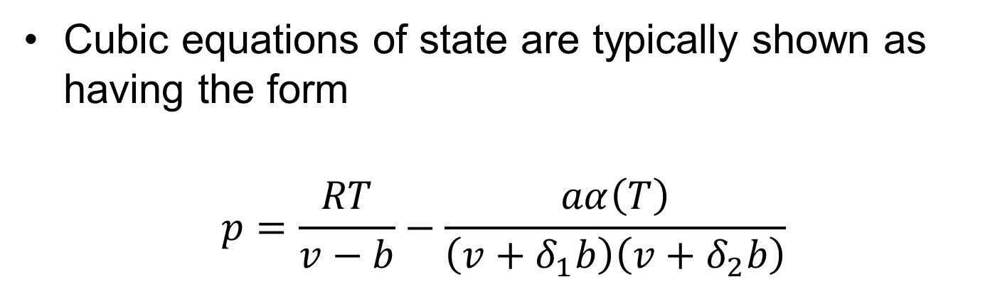
Cubic EoS
Cubic equations of state are typically shown as having the form
$$p=\frac{RT}{v−b}−\frac{aα\left(T\right)}{\left(v+δ_{1}b\right)\left(v+δ_{2}b\right)}$$
Notes:
So, to begin with the simplest class of equations of state capable of capturing phase equilibria: the cubics. Frequently, these are worked with in this form, [NEXT SLIDE]

Slide 7

Cubic EoS
Cubic equations of state are typically shown as having the form
$$p=\frac{RT}{v−b}−\frac{aα\left(T\right)}{\left(v+δ_{1}b\right)\left(v+δ_{2}b\right)}$$
Where the values of $δ$ depend on the equation of state (van der Waals, Peng Robinson, Redlich Kwong)
Notes:
With values of delta_1 and delta_2 depending on the equation of state

Slide 8
Cubic EoS
Cubic equations of state are typically shown as having the form
$$p=\frac{RT}{v−b}−\frac{aα\left(T\right)}{\left(v+δ_{1}b\right)\left(v+δ_{2}b\right)}$$
It is not immediately obvious why we consider these to be “cubic”
Notes:
Unless you have prior experience working with these, it is not usually obvious why we consider this to be a “cubic”, or why that even matters!

Slide 9

Cubic EoS
For simplicity, we will consider the case of van der Waals, where $δ=0$ and$α\left(T\right)=1$
$$p=\frac{RT}{v−b}−\frac{a}{v^{2}}$$
Notes:
So, for the sake of clarity, let us work with the van der Waals equation of state. Here, delta is 0, and our alpha-function is just 1.

Slide 10
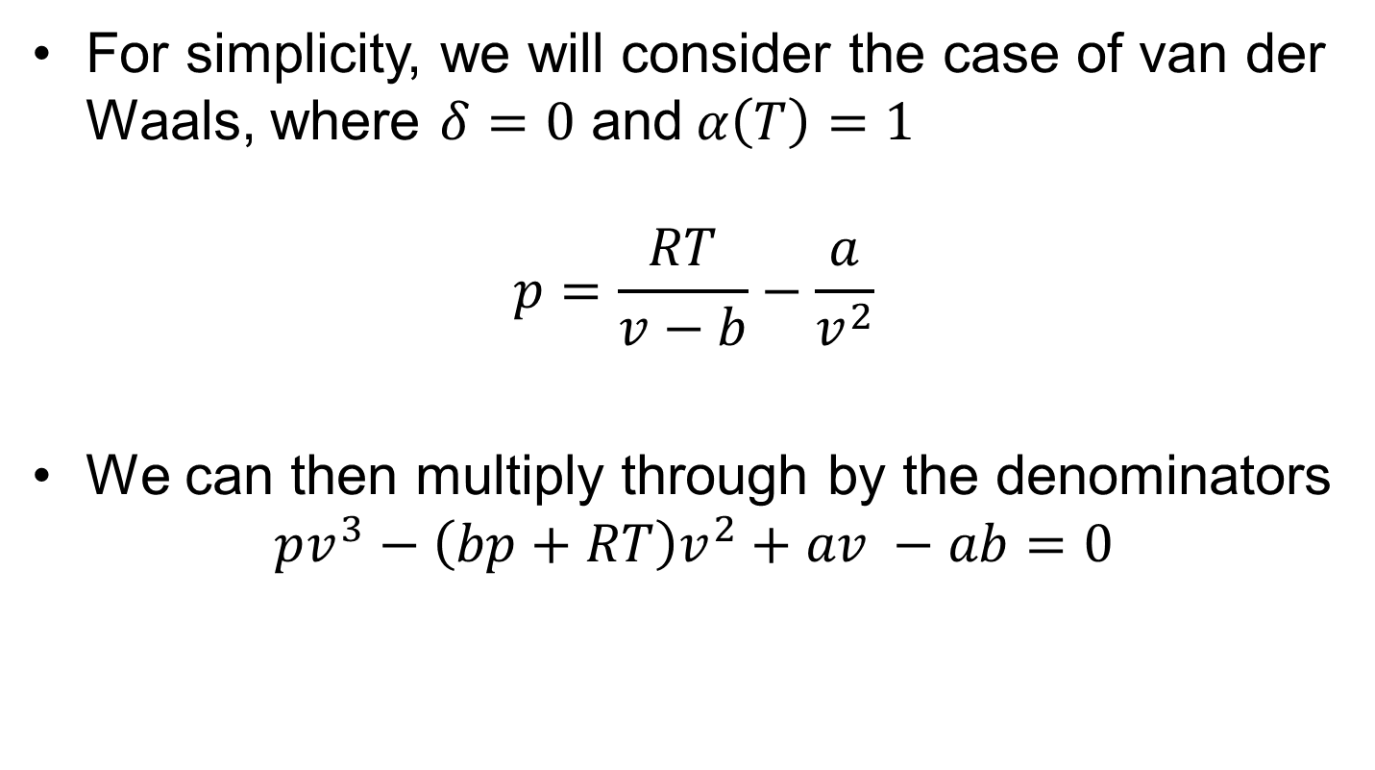
Cubic EoS
For simplicity, we will consider the case of van der Waals, where $δ=0$ and$α\left(T\right)=1$
$$p=\frac{RT}{v−b}−\frac{a}{v^{2}}$$
We can then multiply through by the denominators
$$pv^{3}−\left(bp+RT\right)v^{2}+av −ab=0$$
Notes:
Once we multiply through by the denominators of each fraction, (highlight movement with pen), and tidy up a little by collecting some terms, we see the familiar shape of a cubic polynomial appear

Slide 11

Cubic EoS
We can then multiply through by the denominators
$$pv^{3}−\left(bp+RT\right)v^{2}+av −ab=0$$
Giving us a cubic equation we can solve for $v$!
Notes:
This can now be solved for v analytically!

Slide 12

Cubic EoS
Often, this is defined in terms of the compressibility factor $Z=\frac{pv}{RT}$
Notes:
Often, we express this polynomial in terms of the compressibility factor, where the compressibility factor is a dimensionless expression describing the deviation from ideal gas behaviour

Slide 13
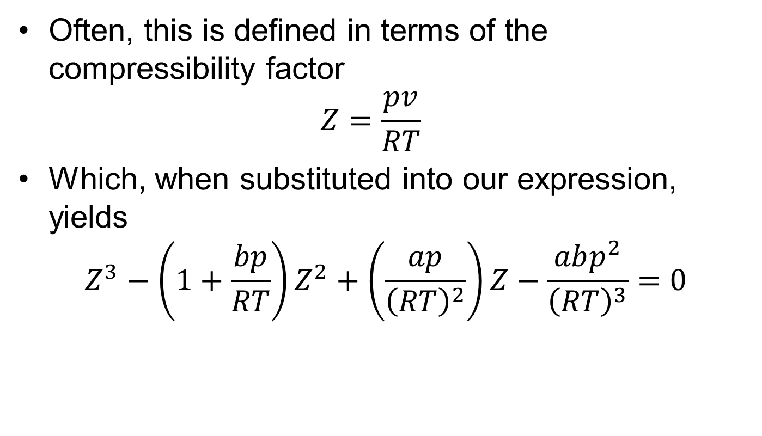
Cubic EoS
Often, this is defined in terms of the compressibility factor $Z=\frac{pv}{RT}$
Which, when substituted into our expression, yields
$$Z^{3}−\left(1+\frac{bp}{RT}\right)Z^{2}+\left(\frac{ap}{{\left(RT\right)}^{2}}\right)Z−\frac{abp^{2}}{{\left(RT\right)}^{3}}=0$$
Notes:
Which, when we substitute into our expression, we get this. Still clearly Cubic, but no longer explicit in volume.

Slide 14
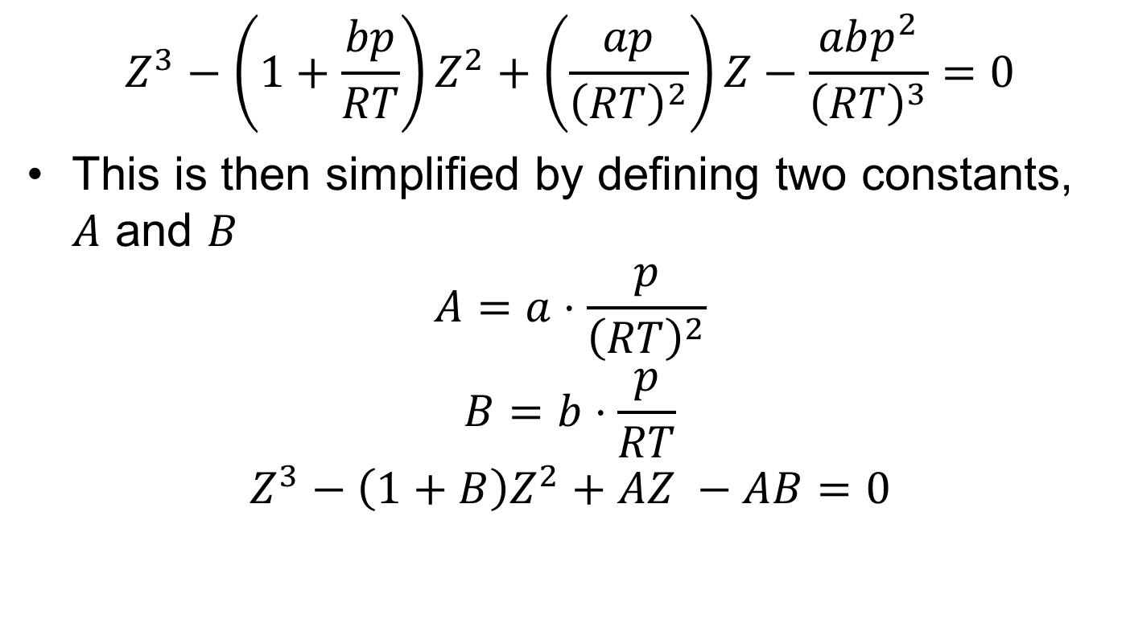
Cubic EoS
$$Z^{3}−\left(1+\frac{bp}{RT}\right)Z^{2}+\left(\frac{ap}{{\left(RT\right)}^{2}}\right)Z−\frac{abp^{2}}{{\left(RT\right)}^{3}}=0$$
This is then simplified by defining two constants, $A$ and $B$
$$A=a⋅\frac{p}{{\left(RT\right)}^{2}}$$
$$B=b⋅\frac{p}{RT}$$
$$Z^{3}−\left(1+B\right)Z^{2}+AZ −AB=0$$
Notes:
Because the expression is somewhat messy, it is common to tidy this up by defining two constants, capital A and capital B.

Slide 15
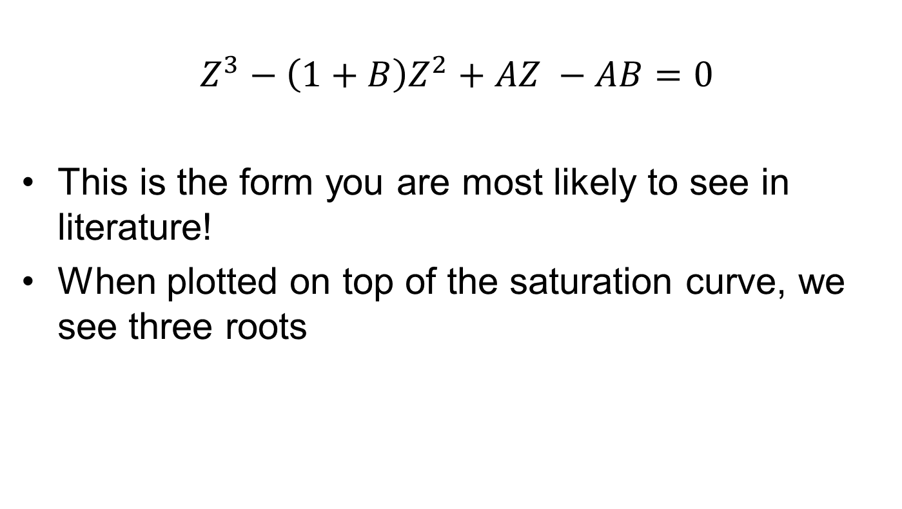
Cubic EoS
$$Z^{3}−\left(1+B\right)Z^{2}+AZ −AB=0$$
This is the form you are most likely to see in literature!
When plotted on top of the saturation curve, we see three roots
Notes:
If you read any textbooks or literature about cubic equations of state, and they discuss the solving of them, this will usually be the form you see

Slide 16
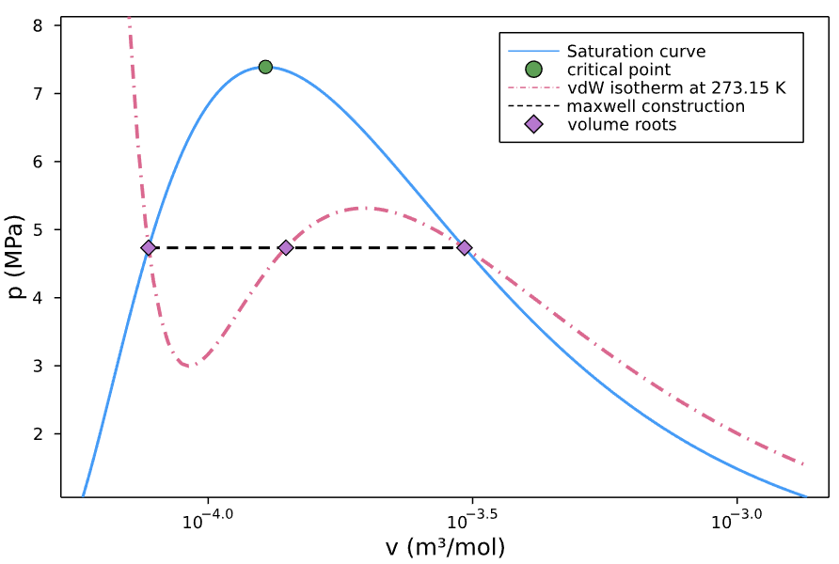
Cubic EoS
Notes:
First thing to note is that when three real roots are found, the middle root is always unphysical. Then, if the point we are evaluated is saturated, the smallest volume root represents the liquid state and the largest volume root represents the vapour state.
Another important feature is the maxwell equal-area construction. Under this

Slide 17
Cubic EoS
All cubic equations are analytically solvable
This allows us to cheaply evaluate all volume roots
When more than one real root is present, the chemical potentials are evaluated and the most stable phase is chosen

Slide 18
Cubic EoS
Show implementation in notebook
Notes:
poly = [-A*B, A, -(1+B), 1.0] # Polynomial coefficients
Zvec = roots(poly) # Solve polynomial for Z
Vvec = Zvec.*(R*T/p) # Transform to volume

Slide 19
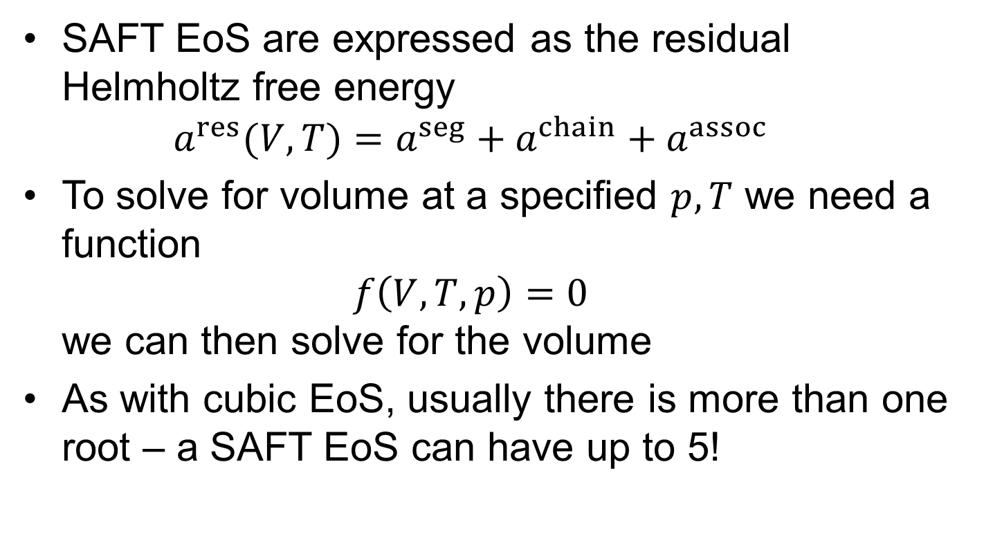
SAFT EoS
SAFT EoS are expressed as the residual Helmholtz free energy $a^{res}(V, T)=a^{seg}+a^{chain}+a^{assoc}$
To solve for volume at a specified $p, T$ we need a function $f\left(V, T,p\right)=0$ we can then solve for the volume
As with cubic EoS, usually there is more than one root – a SAFT EoS can have up to 5!

Slide 20
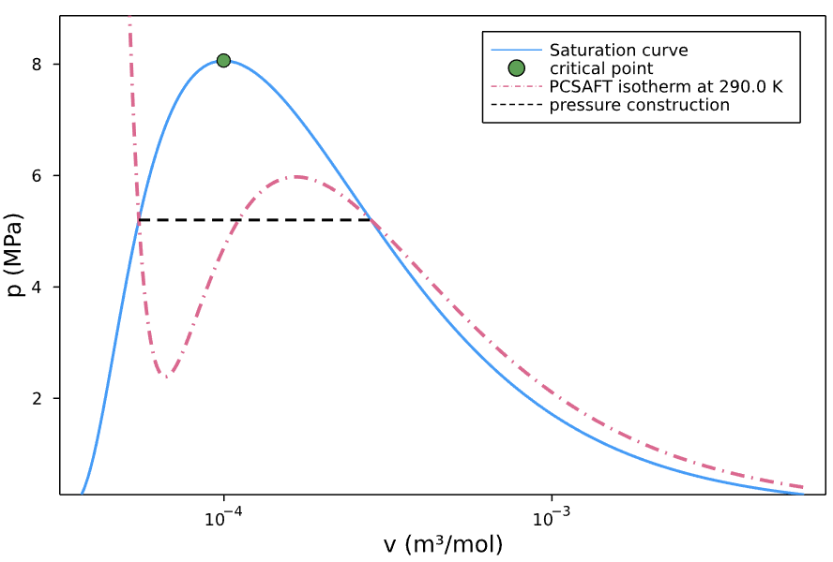
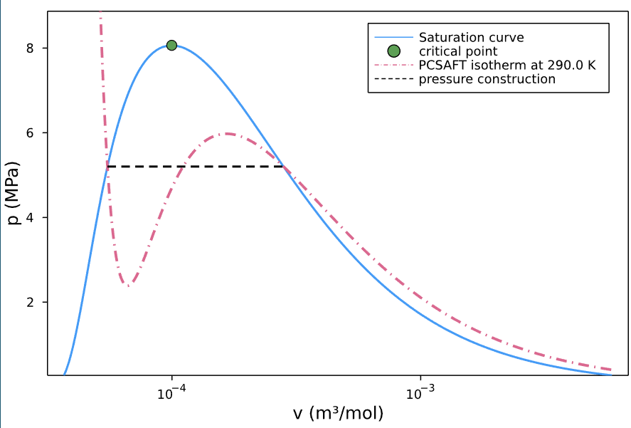
SAFT EoS
Typical case for PCSAFT:

Slide 21
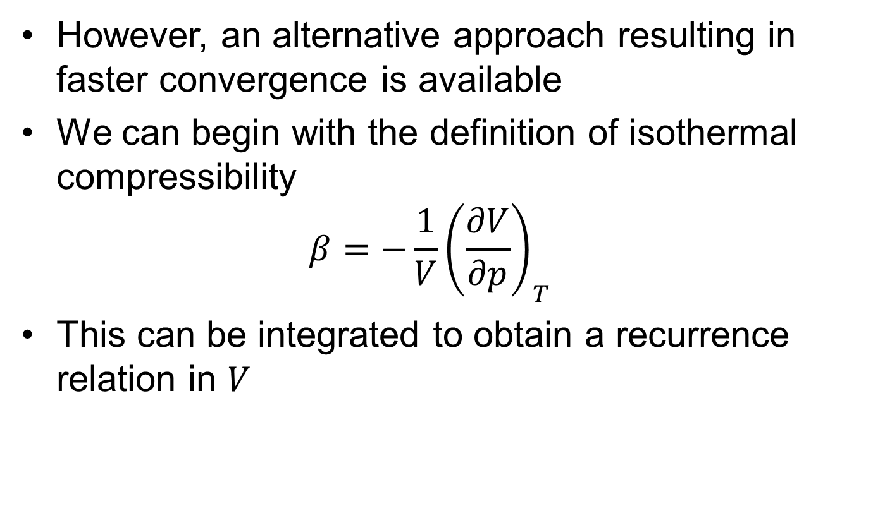
SAFT EoS
However, an alternative approach resulting in faster convergence is available
We can begin with the definition of isothermal compressibility $β=−\frac{1}{V}{\left(\frac{∂V}{∂p}\right)}_{T}$
This can be integrated to obtain a recurrence relation in $V$

Slide 22
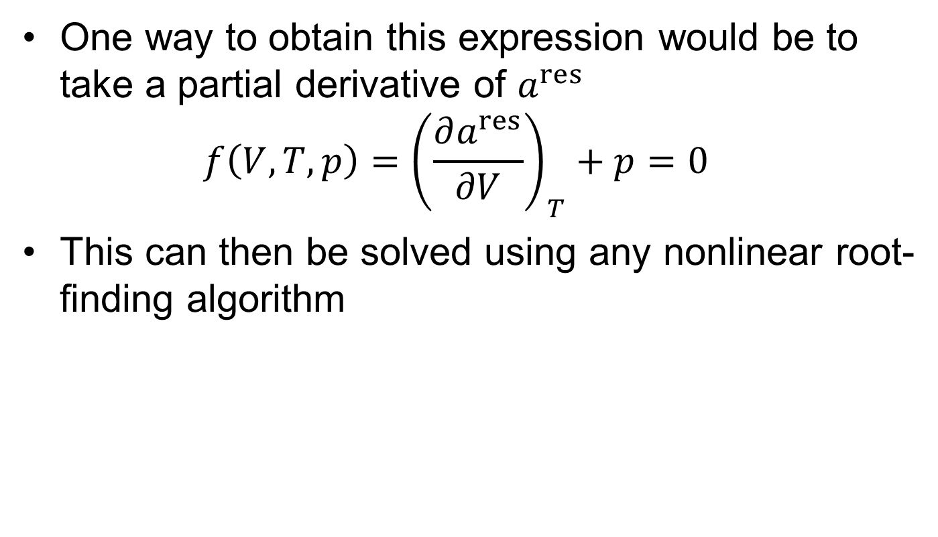
SAFT EoS
One way to obtain this expression would be to take a partial derivative of $a^{res}$ $f\left(V,T,p\right)={\left(\frac{∂a^{res}}{∂V}\right)}_{T}+p=0$
This can then be solved using any nonlinear root-finding algorithm

Slide 23
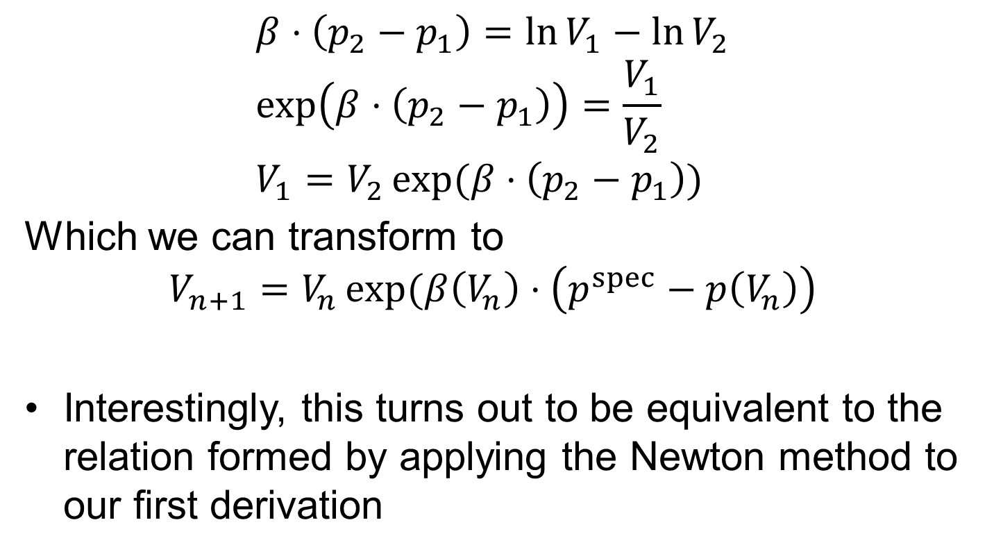
SAFT EoS
$$β⋅\left(p_{2}−p_{1}\right)=\ln{V_{1}}−\ln{V_{2}} \\ \exp\left(β⋅\left(p_{2}−p_{1}\right)\right)=\frac{V_{1}}{V_{2}} \\ V_{1}=V_{2}\exp{(β⋅\left(p_{2}−p_{1}\right))}$$
Which we can transform to
$$V_{n+1}=V_{n}\exp{(β\left(V_{n}\right)⋅\left(p^{spec}−p\left(V_{n}\right)\right)}$$
Interestingly, this turns out to be equivalent to the relation formed by applying the Newton method to our first derivation

Slide 24
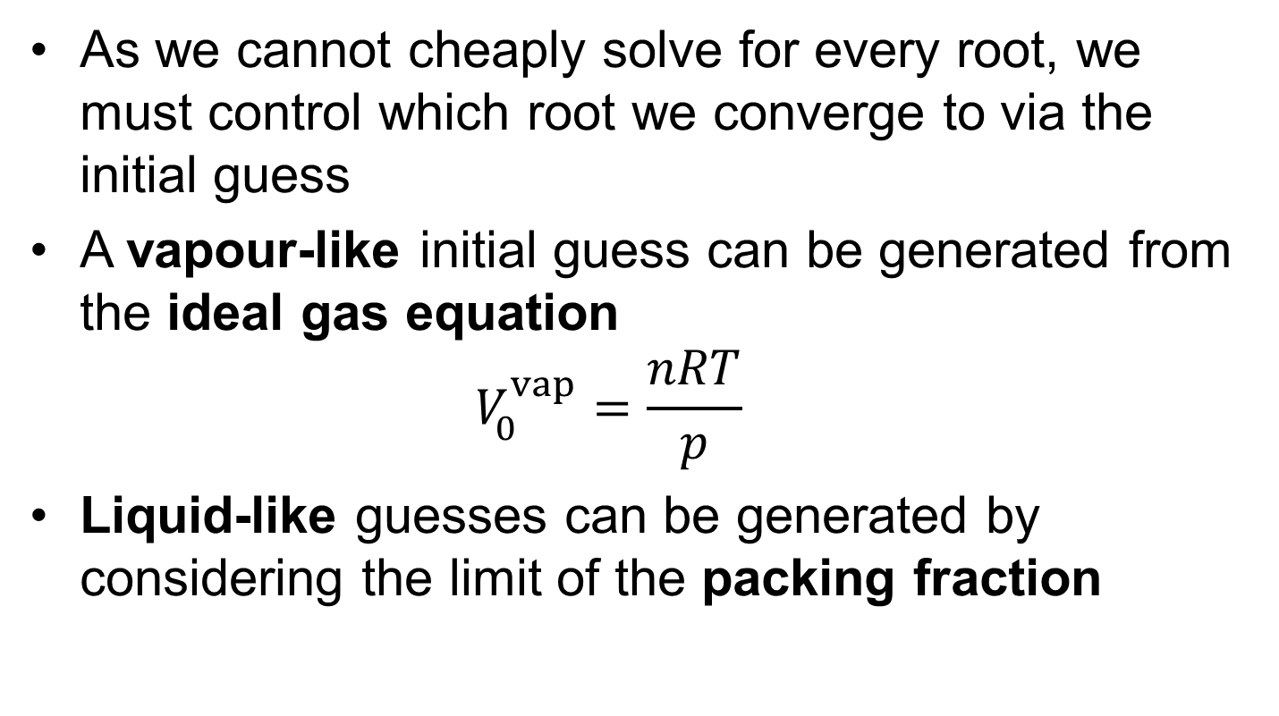
Initial Guesses
As we cannot cheaply solve for every root, we must control which root we converge to via the initial guess
A vapour-like initial guess can be generated from the ideal gas equation $V_{0}^{vap}=\frac{nRT}{p}$
Liquid-like guesses can be generated by considering the limit of the packing fraction

Slide 25
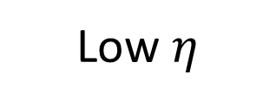
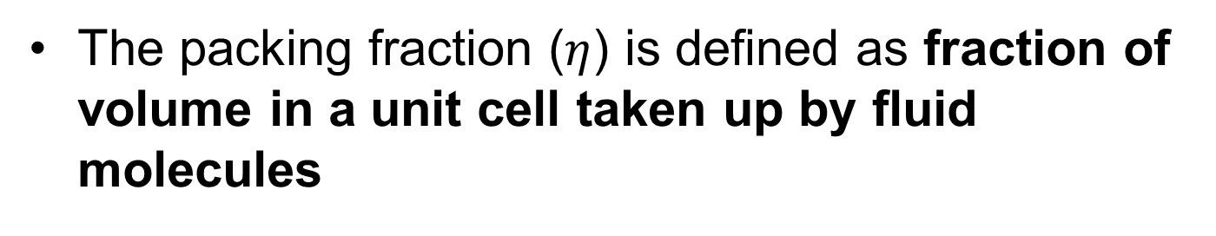

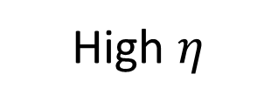
Initial Guesses
The packing fraction ($η$) is defined as fraction of volume in a unit cell taken up by fluid molecules
Low $η$
High $η$
$$η→1$$

Slide 26
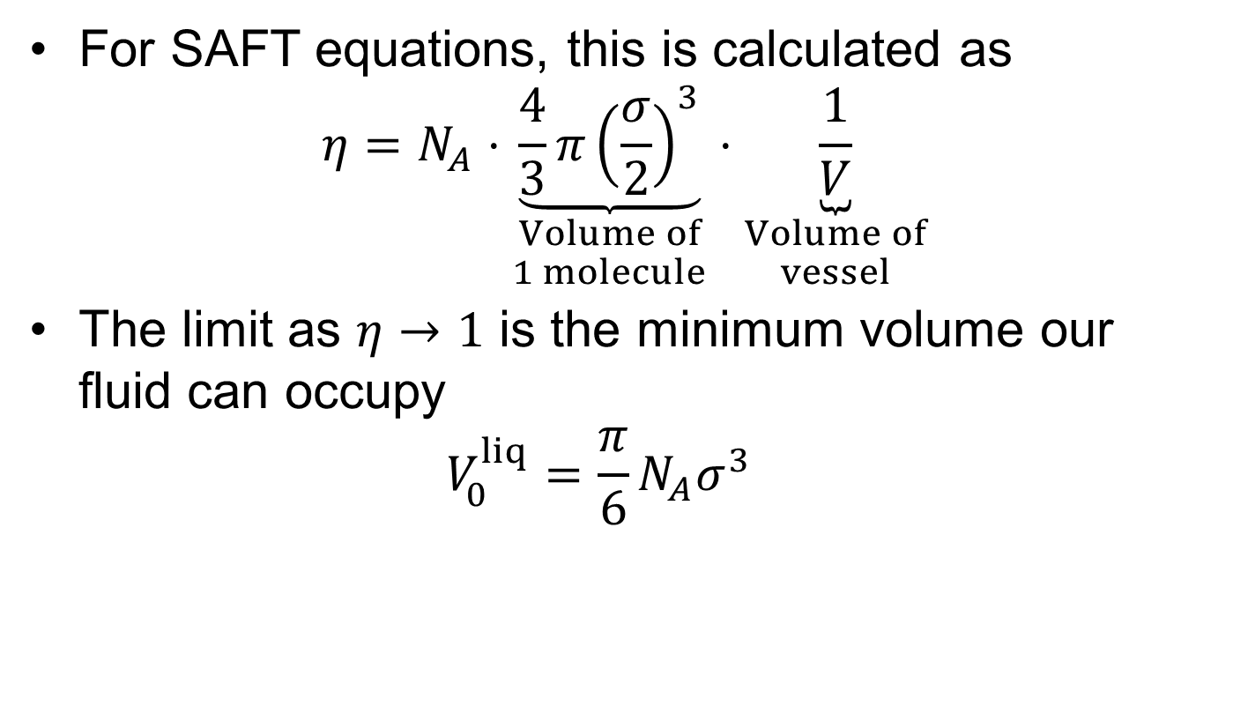
Initial Guesses
For SAFT equations, this is calculated as $η=N_{A}⋅\underset{\begin{aligned}Volume of \\ 1 molecule\end{aligned}}{\underbrace{\frac{4}{3}π{\left(\frac{σ}{2}\right)}^{3}}}⋅\underset{\begin{aligned}Volume of \\ vessel\end{aligned}}{\underbrace{\frac{1}{V}}}$
The limit as $η→1$ is the minimum volume our fluid can occupy $V_{0}^{liq}=\frac{π}{6}N_{A}σ^{3}$

Slide 27
Implementation
Switch to notebook to show implementation

Slide 28
Key messages
The primary advantage of cubic EoS is how cheap they are to solve for the volume at a given pT
SAFT EoS must be solved numerically
The root converged to for SAFT EoS is controlled through the initial guess
Generally, both liquid and vapour roots should be converged to determine which is more stable

Slide 29
Convergence
Typically this method converges quickly and reliably

